Slide 1
SCRAMBLE PUZZLE SOLVER DIP Semester Project
PREPARED BY:
ALI AHMAD (FA19-BCS-027)
MUHAMAMD WAHAJ (FA19-BCS-084)
MUHAMAMD UMAIR (SP19-BCS-139)

Slide 2
Working:
Scramble puzzle solver is the solver which take input image from user having puzzle and perform specific function to derived meaningful and desired words .The objective of Scramble Puzzle solver is to solve the puzzles with accurate result. This Scramble solver will be used in making of Scramble itself as it can be used to check whether this puzzle is valid or not (have any combinations or not). Also, a user can use it to verify whether he has correctly solved it. Furthermore, our aim is to make it so perfect that it would solve world’s hardest Scramble in seconds.
Related Work
Related work for this project can be found on the link below:
https://github.com/neeru1207/AI_Sudoku

Slide 3
Steps:
Steps | Description
Gaussian Blurring | Blurring the image to reduce noise and details in the image.
Adaptive Gaussian Thresholding | This will be used to illuminate different parts of the image.
Inverting | Image will be inverted to better recognize the characters in it.
Flood Filling | To identify the largest area in the image that will be a box which contains all words.
Hough Line Transform | To find all the lines in the detected box.
Merging | The intersections will be merged to form a line in soft form. This will give us the box
Finding the four intersection points | Identify the four points of the box
Warping perspective | To find the matrix and crop the box out of the image
Thresholding and inverting | To find the characters in the box
Breaking image into individual character | To identify the characters in the image.
Input word to be searched | Enter word to search in the identified matrix
.

Slide 4
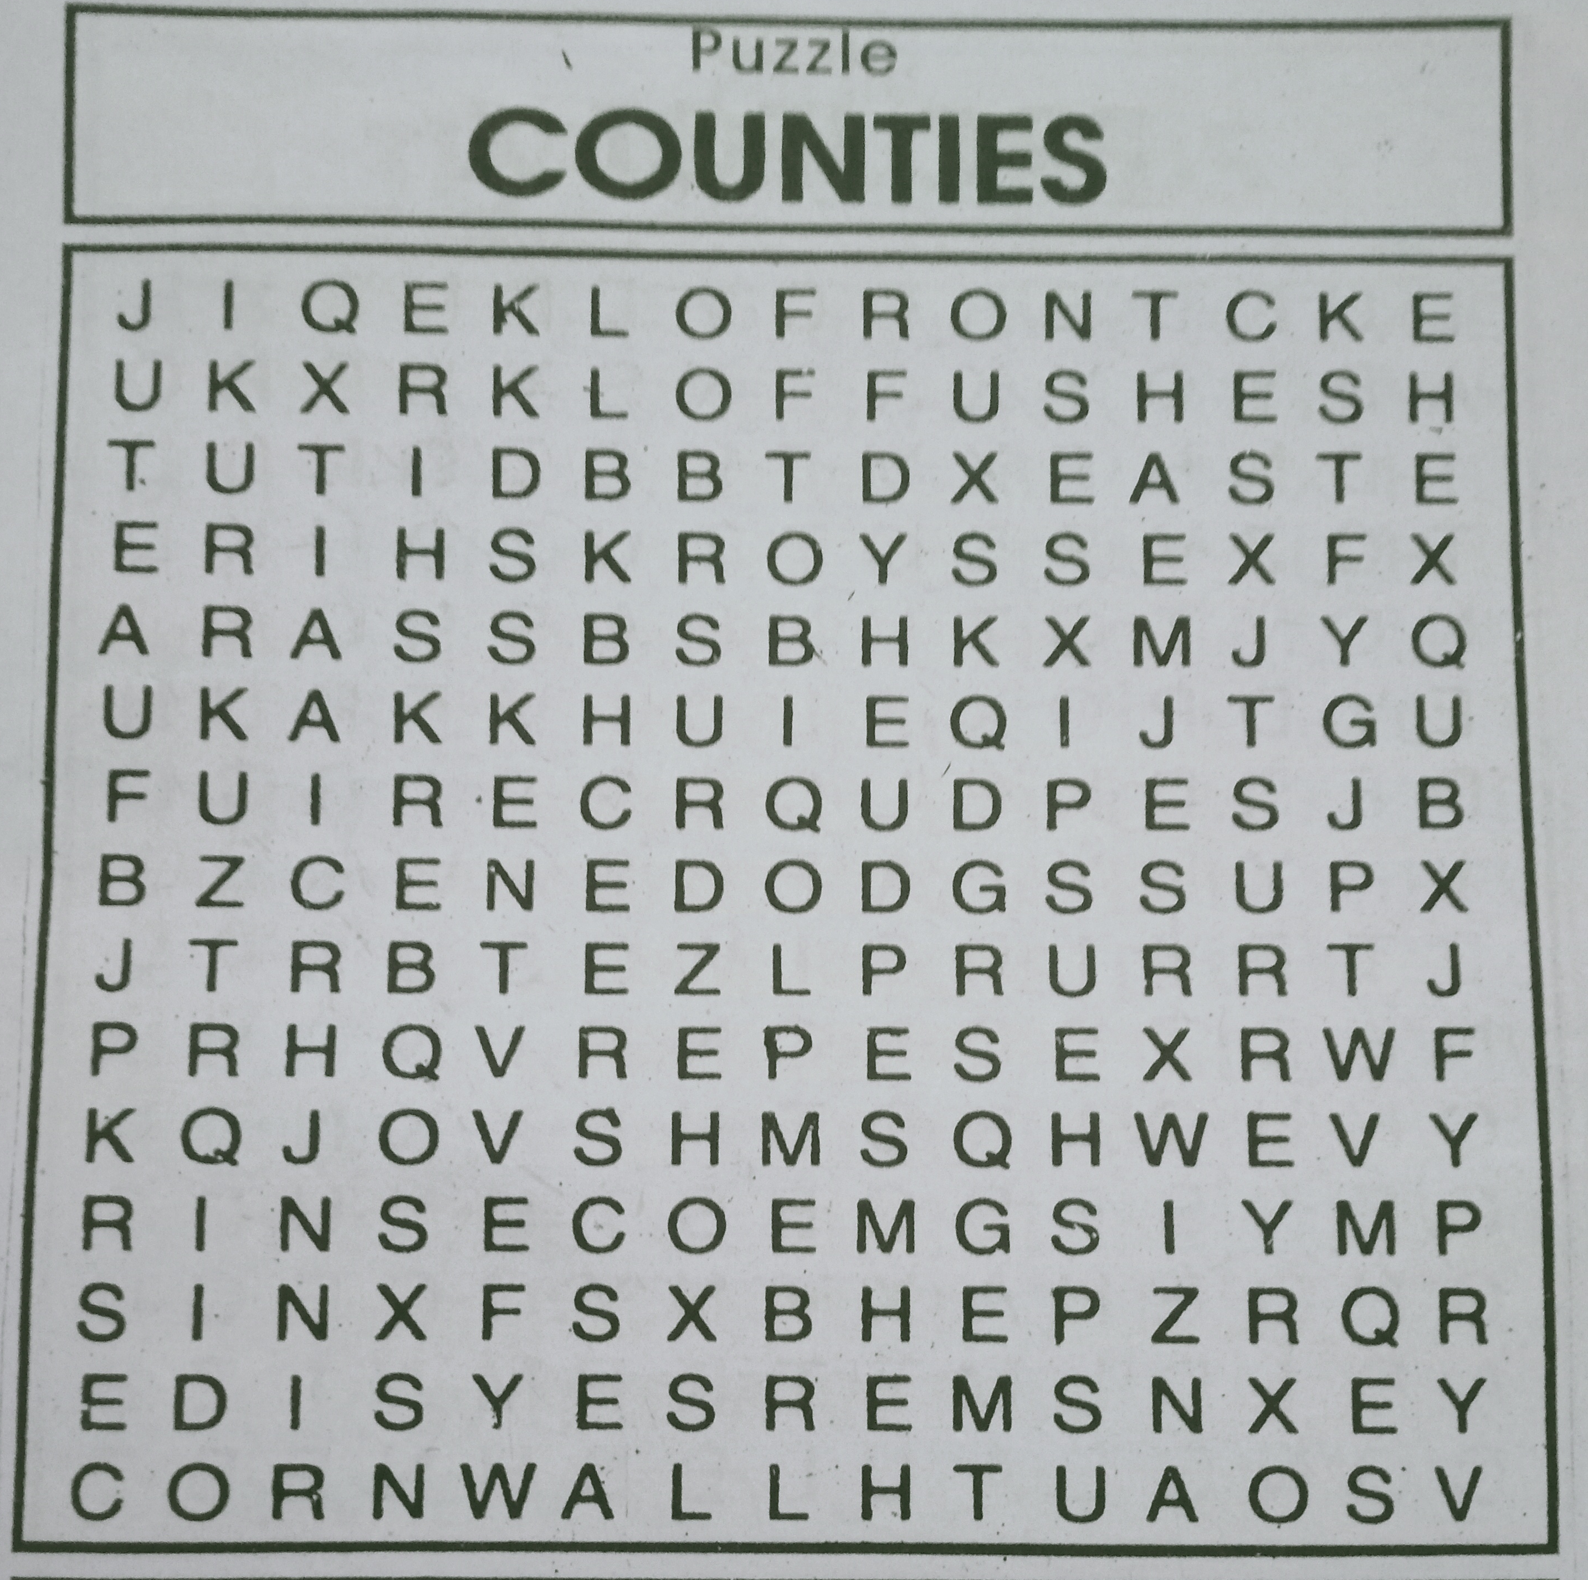
Input Image:
01
02
03
04
Information
.
You can describe the topic of the section here
Technology
Into the future
You can describe the topic of the section here

Slide 5
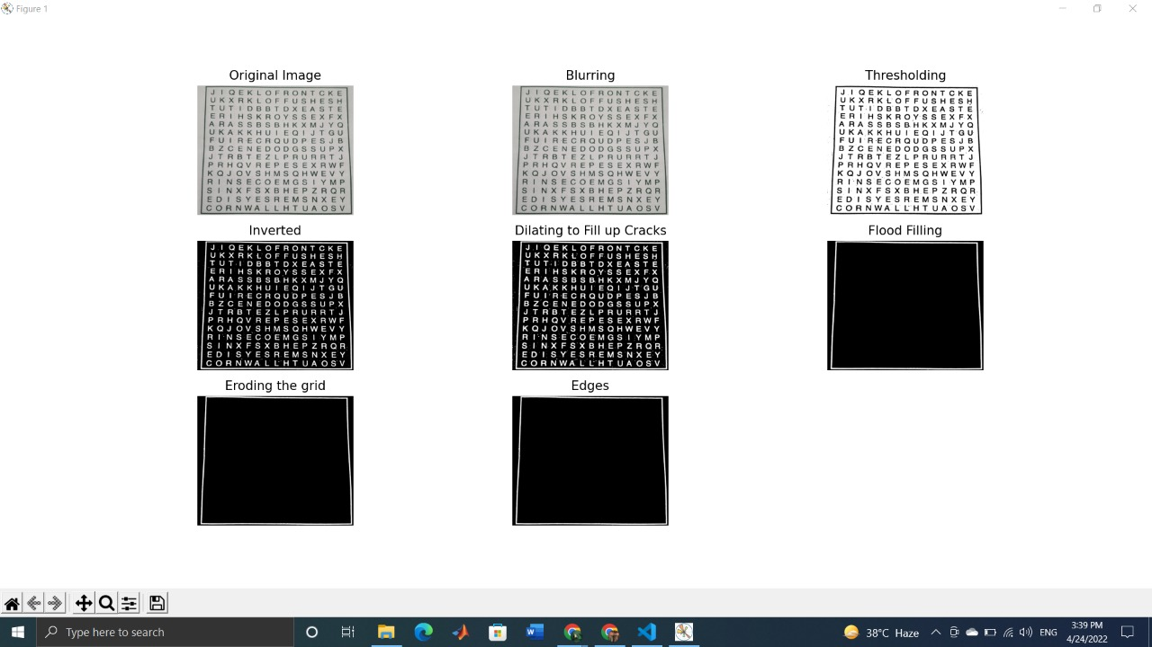
01
Gaussian Blurring
The Gaussian blur is a type of image-blurring filter that uses a Gaussian function for calculating the transformation to apply to each pixel in the image.
Python command:
cv2.GaussianBlur(img,(3,3),0)

Slide 6
02
Adaptive Thresholding
Adaptive thresholding is the method where the threshold value is calculated for smaller regions and therefore, there will be different threshold values for different regions.
Python command:
img = cv2.cvtColor(blur, cv2.COLOR_BGR2GRAY)
thresh2 = cv2.adaptiveThreshold(img, 255, cv2.ADAPTIVE_THRESH_GAUSSIAN_C,cv2.THRESH_BINARY, 199, 5)

Slide 7
03
Inverting:
Image will be inverted to better recognize the characters in it. Inverting to make the digits and lines white while making the background black.It means the pixel having value 0 is converted into 1 and vice versa
Python command:
cv2.bitwise_not(thresh2)

Slide 8
04
Dilation:
Dilation adds pixels to the boundaries of objects in an image, while erosion removes pixels on object boundaries. The number of pixels added or removed from the objects in an image depends on the size and shape of the structuring element used to process the image. It is used to fill out any cracks in the board lines and thicken the board lines.
Python command:
cv2.dilate(inverted_image, kernel, iterations=1)

Slide 9
05
Flood Filling:
The board will probably be the largest blob connected component with the largest area, flood filling from different seed points and finding all connected components followed by finding the largest flood filled area region will give the board. Means it make the boundry of board more prominent.

Slide 10

Continue
06
Hough Line Transform
The Hough transform is a feature extraction and The purpose of the technique is to find imperfect instances of objects within a certain class of shapes. In our case it used to find all the lines in the detected outer box.
07
Merging
The lines found by the Hough Transform that are close to each other are fused together.

Slide 11
Continue
08
Finding the four intersection points
We find the border lines by choosing the nearest line from the top with slope almost 0 as the upper edge, the nearest line from the bottom with slope almost 0 as the lower edge, the nearest line from the left with slope almost infinity as the left edge and the nearest line from the right with slope almost infinity as the right edge.
09
Warping perspective
We find the perspective matrix using the end points, correct the perspective and crop the board out of the original image.

Slide 12
Continue
10
Slicing
Slicing the grid to get images of each cell of the puzzle board.

Slide 13
Done So far:
Gaussian Blurring
Adaptive Gaussian Thresholding
Inverting
Flood Filling
Hough Line Transform
Merging
Finding the four intersection points
Warping side
Slicing

Slide 14
Thanks!
Do you have any questions?

